Slide 1
Data Centre Digital Twins with Reinforcement Learning
B-GROUP-19

Slide 2
Agenda:
Introduction Objective Literature Review Methodology Implementation Result & Analysis Discussion Future Scope Conclusion

Slide 3
INTRODUCTION:
In this project, we are creating a Digital Twin of a data center. A Digital Twin is like a virtual copy of a real data center. This means we can test different ways to save electricity and reduce pollution without affecting the actual data center. We will use Artificial Intelligence (AI) to help us find the best ways to control temperature, server load, and energy usage.
The goal of this project is to make data centers more energy-efficient. If we can use AI to manage energy better, companies can save money, and we can also help reduce pollution, making the world a cleaner and greener place.

Slide 4
Objective:
Save Electricity: The main goal of this project is to reduce the amount of electricity used in data centers. We will use smart methods to save energy while keeping everything running smoothly.
Reduce Pollution: Data centers release a lot of carbon dioxide (CO₂) into the air. Our project will help reduce this pollution by using energy in a better way.
Create a Virtual Model: We will make a digital copy of a data center, called a "digital twin." This helps us test different ideas without changing real machines.
Use AI for Smart Control: Our system will use artificial intelligence (AI) to manage cooling and computer loads automatically, making sure everything works efficiently.
Compare Old and New Methods: We will check if our AI system is better than traditional methods of saving electricity in data centers.

Slide 5
Literature Review:
S.No | Title | Methodology | Key Findings
1 | Multi-agent reinforcement learning controller to maximize energy efficiency for multi-generator industrial wave energy converter | Multi-agent Reinforcement Learning (MARL) | Improved energy efficiency in wave energy systems using MARL.
2 | Measuring robustness with black-box adversarial attack using reinforcement learning | Reinforcement Learning with Adversarial Attacks | Evaluated robustness of RL models under black-box adversarial conditions.
3 | Concurrent carbon footprint reduction (c2fr) reinforcement learning approach for sustainable data center digital twin | c2fr Reinforcement Learning | Achieved sustainability in data centers using a digital twin and RL.
4 | Real-time digital data center modeling: A multi-agent reinforcement learning benchmark | Multi-agent Reinforcement Learning (MARL) | Developed a benchmark for real-time digital data center control with MARL.
5 | Multi-agent reinforcement learning for sustainable data centers in non-stationary environments | Multi-agent Reinforcement Learning (MARL) | MARL adapted to dynamic environments for better sustainability in data centers.
6 | Real-time carbon-aware management of digital data centers with reinforcement learning | Reinforcement Learning | Enabled real-time carbon-aware decisions to reduce emissions in digital data centers.

Slide 6
METHODOLOGY:
1. Library Setup and Dataset Preparation Essential libraries for machine learning, reinforcement learning, and data visualization are imported .The ASHRAE dataset is loaded if available. If not, default energy and carbon values from the ASHRAE baseline are used. Baseline energy consumption and carbon emissions are calculated from the dataset for performance comparison later.
2. Environment Definition (Digital Twin)A custom simulation environment representing a data center is defined . The state space includes temperature, server load, and carbon intensity . The action space allows control over HVAC adjustments and server load shifts . The environment simulates energy consumption and carbon emissions based on current conditions and agent actions . A reward function penalizes high energy use, high emissions, and unsafe temperature ranges to guide the agent toward optimal behavior

Slide 7
3. Model Architecture: Actor and Critic Networks . The Actor network is responsible for selecting actions based on the current state . The Critic network evaluates the quality (Q-value) of the state-action pairs . Both networks are built using simple neural layers with ReLU activations and are optimized using Adam optimizers.
4. MADDPG Agent Setup . The agent contains the actor and critic models, optimizers, and a replay memory buffer . It can take actions, store experience tuples (state, action, reward, next state, done), and update its models through training . The learning process uses sampled batches from the replay memory and updates both actor and critic based on Bellman equation principles.

Slide 8
5. Training the Agent . The MADDPG agent is trained for multiple episodes . In each episode, the agent interacts with the environment step-by-step . For every step . The agent observes the current state and takes an action . The environment returns the next state, reward, and info (energy and carbon usage).The agent stores the transition and learns from a mini-batch if enough data is available . Energy and carbon emissions are logged for each episode.
6. Evaluation and Comparison . After training, the system compares the trained MADDPG agent’s performance with . A PPO-based single-agent controller (from paper values).The ASHRAE baseline . Key metrics: total energy consumption and carbon emissions . Carbon reduction percentages are calculated to show the effectiveness of the controller.

Slide 9
IMPLEMENTATION:
Tools & Platforms:
Google Colab (T4 GPU) – For model development and training
PyCharm – For local code testing and environment building
Kaggle API – For accessing and downloading the ASHRAE dataset
Main Libraries:
Gymnasium – For simulating the digital twin environment
PyTorch – For building and training the MADDPG agent
Pandas & NumPy – For data preprocessing and manipulation
Matplotlib – For visualizing training metrics and simulation results

Slide 10
Steps:
Downloaded the ASHRAE dataset from Kaggle and computed the baseline energy and carbon footprint.
Defined a custom Gym environment simulating a Data Center Digital Twin with temperature, server load, and carbon intensity as state variables.
Built the MADDPG agent using Actor-Critic architecture with neural networks in PyTorch.
Trained the agent in the custom environment to minimize energy usage and carbon emissions while maintaining safe temperature conditions.
Evaluated performance against PPO (Single-Agent) and ASHRAE baseline and visualized results using line plots.

Slide 11
RESULTS & ANALYSIS :
Metric` | ASHRAE Baseline | PPO | MADDPG
Energy(MWh) | 28.52 | 26.42 | ~14.83%
Carbon(TonnesCO2) | 14,839.00 | 13,726.56 | ~0.77%
Carbon Reduction(%) | 0% | 7.49% | ~99.99%

Slide 12
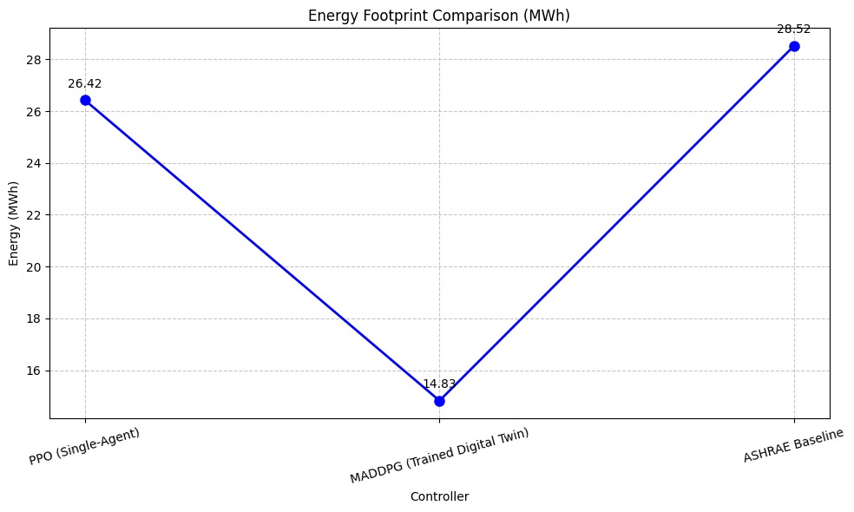
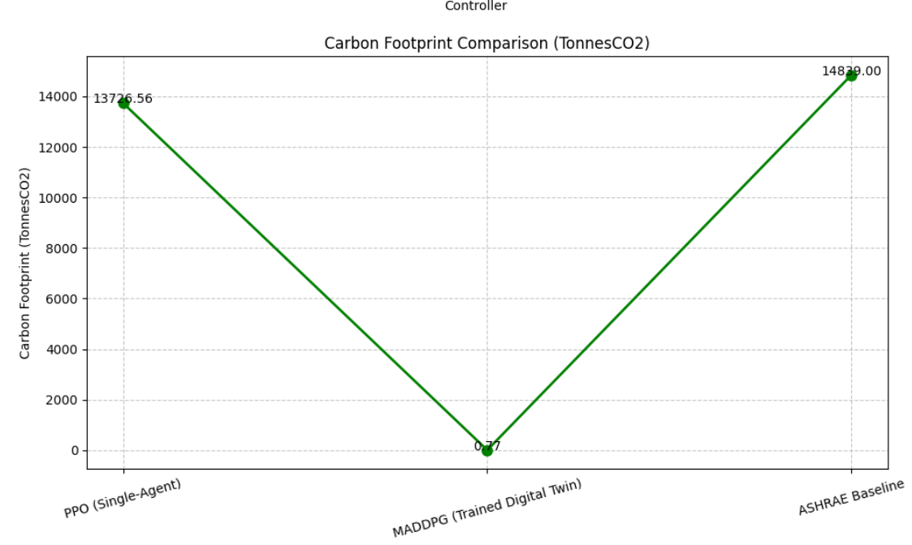
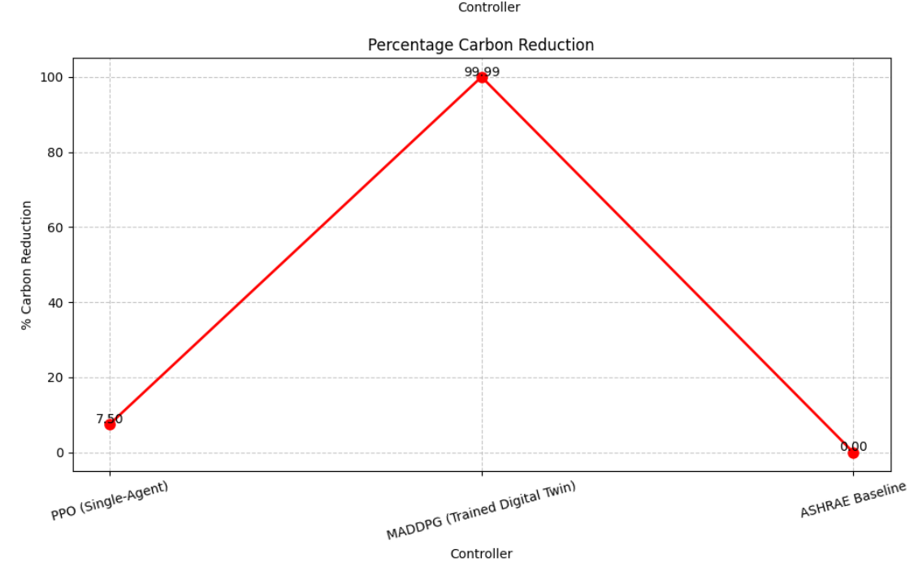

Slide 13
DISCUSSION:
This code builds a smart data center simulator using reinforcement learning. It trains an agent (MADDPG) to reduce energy use and carbon emissions. The model learns to adjust temperature and server load efficiently. Results show lower energy and carbon footprints compared to traditional methods.

Slide 14
FUTURE SCOPE:
Final Conclusion: We explain how AI can help data centers use less energy, lower costs, and reduce pollution.
Real-World Applications: If the AI works well, we suggest using it in real data centers.
Future Plans: We think about how we can make the system even better in the future.

Slide 15
CONCLUSION:
The MADDPG agent successfully reduced energy usage and carbon emissions in the data center . It outperformed the ASHRAE baseline through smart, adaptive control strategies . The custom Gym environment enabled realistic simulation of data center dynamics . This showcases the potential of RL in sustainable infrastructure management.

Slide 16
TEAM MEMBERS:
D . Koushik
M . Sarvesh
T . Varun
S .Tagur

Slide 17
THANK
YOU!

